Slide 1


Paramètres de Classic McEliece adaptés au calcul en mémoire
Demi-Journée Cryptographie Post-Quantique
Institut Cybersécurité Occitanie
3 Avril 2024
Cyrius NUGIER

Slide 2
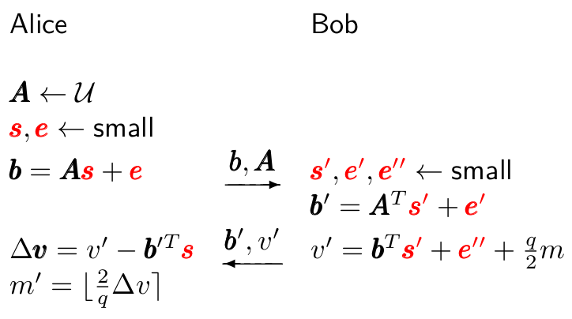
1

Slide 3
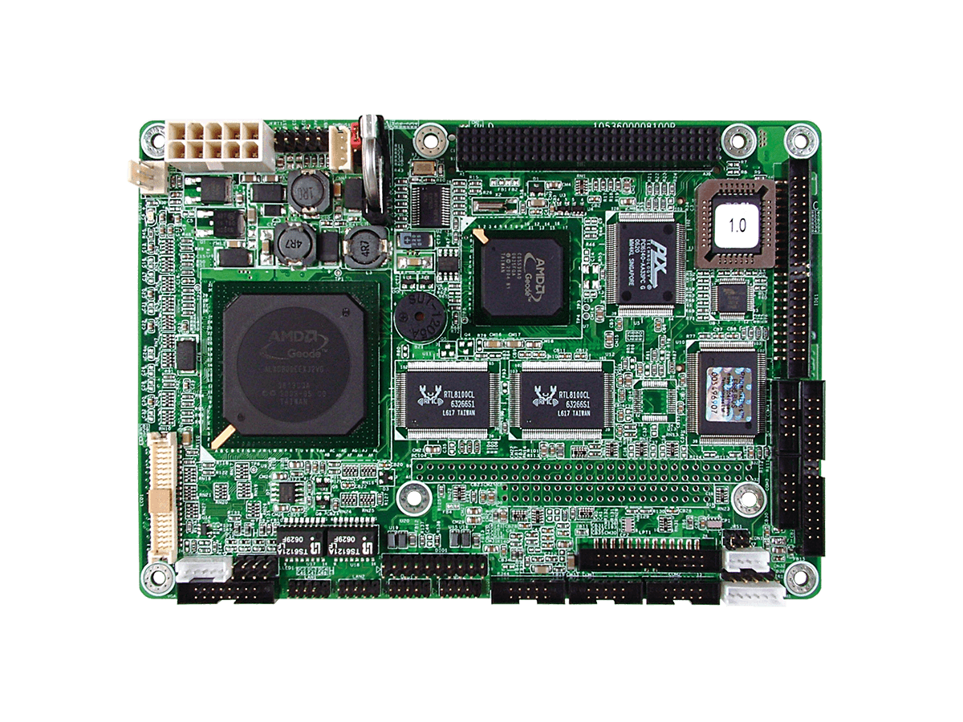
=
+
1

Slide 4
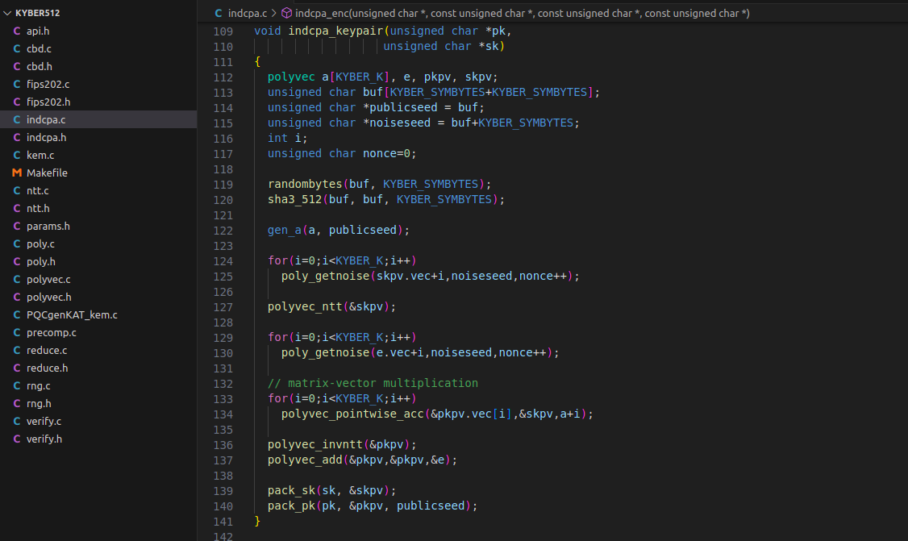
=
+
1

Slide 5
SK size
PK size
CT size
Keygen
Encrypt
Decrypt
Kyber
SK size
PK size
CT size
Keygen
Encrypt
=
+
Decrypt
SK size
HQC
PK size
CT size
Keygen
Encrypt
Decrypt
NTRU
SK size
PK size
CT size
Keygen
Encrypt
Decrypt
McEliece
1

Slide 6
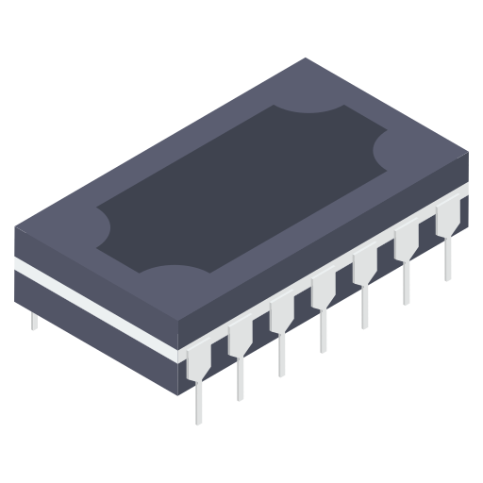
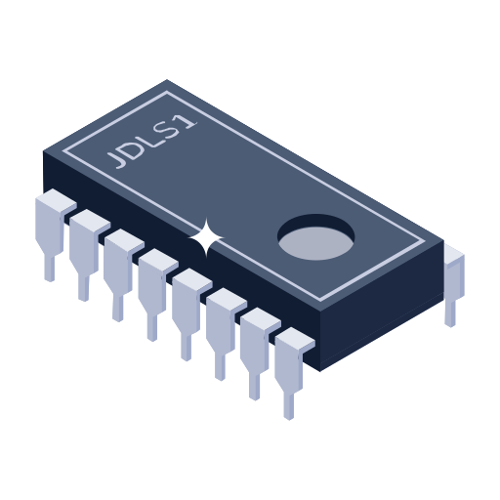



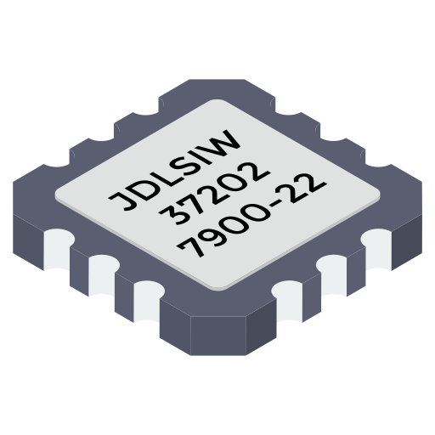
SK size
PK size
CT size
Keygen
Encrypt
Decrypt
Kyber
SK size
PK size
CT size
Keygen
Encrypt
=
+
Decrypt
SK size
HQC
PK size
CT size
Keygen
Encrypt
Decrypt
NTRU
SK size
PK size
CT size
Keygen
Encrypt
Decrypt
McEliece
1

Slide 7
SK size
PK size
CT size
Keygen
Encrypt
Decrypt
Kyber
SK size
PK size
CT size
Keygen
Encrypt
=
+
Decrypt
SK size
HQC
PK size
CT size
Keygen
Encrypt
Decrypt
NTRU
SK size
PK size
CT size
Keygen
Encrypt
Decrypt
McEliece
1

Slide 8

SK size
PK size
CT size
Keygen
Encrypt
Decrypt
Kyber
SK size
PK size
CT size
Keygen
Encrypt
=
+
Decrypt
SK size
HQC
PK size
CT size
Keygen
Encrypt
Decrypt
NTRU
SK size
PK size
CT size
Keygen
Encrypt
Decrypt
McEliece

Slide 9

SK size
PK size
CT size
Keygen
Encrypt
Decrypt
Kyber
SK size
PK size
CT size
Keygen
Encrypt
=
+
Decrypt
SK size
HQC
PK size
CT size
Keygen
Encrypt
Decrypt
NTRU
SK size
PK size
CT size
Keygen
Encrypt
Decrypt
McEliece
1

Slide 10
SK size
PK size
CT size
Keygen
Encrypt
Decrypt
Kyber
SK size
PK size
CT size
Keygen
Encrypt
=
+
Decrypt
SK size
HQC
PK size
CT size
Keygen
Encrypt
Decrypt
NTRU
SK size
PK size
CT size
Keygen
Encrypt
Decrypt
McEliece
1

Slide 11


SK size
PK size
CT size
Keygen
Encrypt
Decrypt
Kyber
SK size
PK size
CT size
Keygen
Encrypt
=
+
Decrypt
SK size
HQC
PK size
CT size
Keygen
Encrypt
Decrypt
NTRU
SK size
PK size
CT size
Keygen
Encrypt
Decrypt
McEliece
1

Slide 12
SK size
PK size
CT size
Keygen
Encrypt
Decrypt
Kyber
SK size
PK size
CT size
Keygen
Encrypt
=
+
Decrypt
SK size
HQC
PK size
CT size
Keygen
Encrypt
Decrypt
NTRU
SK size
PK size
CT size
Keygen
Encrypt
Decrypt
McEliece
1

Slide 13
Central
Processing
Unit
Control Unit
Registers
Arithmetic Logical Unit
L1
Cache
L2 / L3
Main Memory
2

Slide 14
Central
Processing
Unit
Control Unit
Registers
Arithmetic Logical Unit
SIMD
Registers
SIMD Extension
L1
Cache
L2 / L3
Main Memory
2

Slide 15
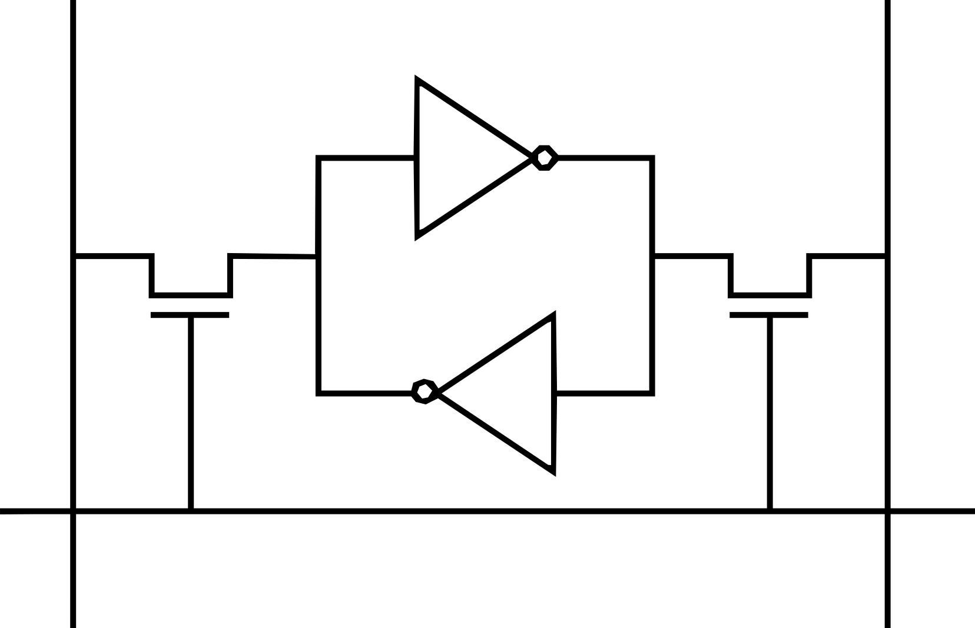
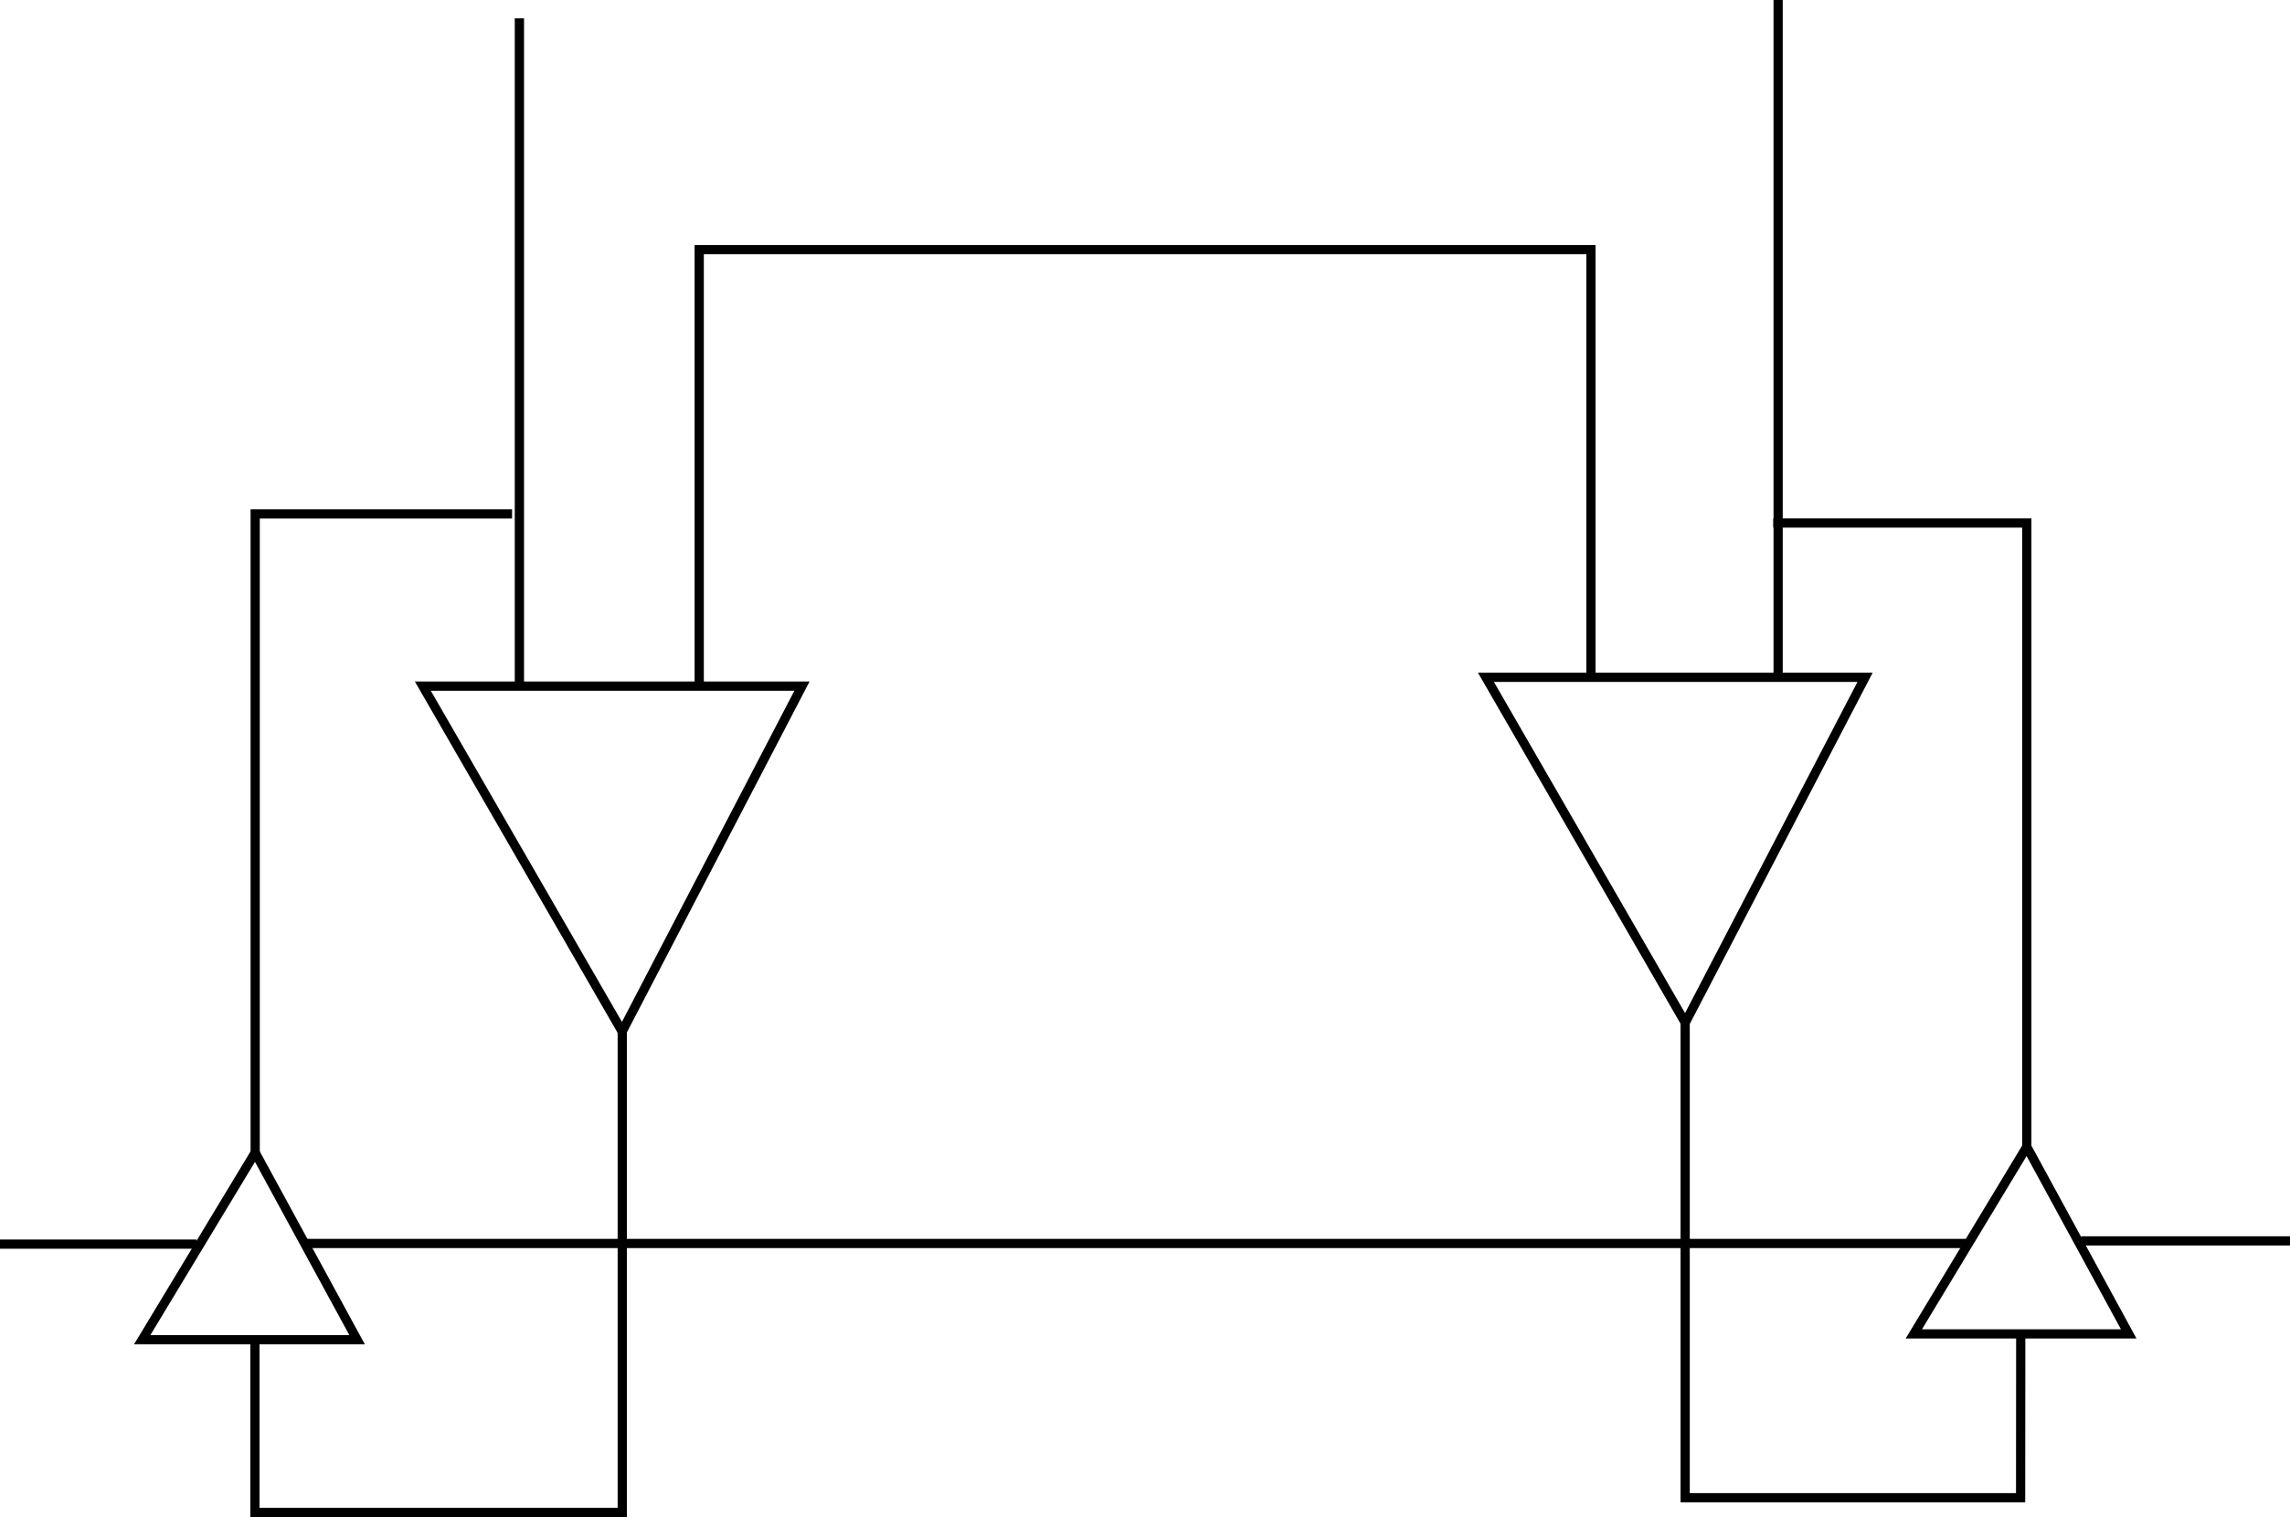
L1 Cache 16Ko
L1
Cache
L2 / L3
Bit-line
...
Word-line
...
...
...
...
...
...
Column Peripheral
And, Or, Xor, Not
Nand, …
3

Slide 16
L1 Cache 16Ko
32 Ways
4096 bits
64 Bytes
8 Banks
4

Slide 17
Central
Processing
Unit
Control Unit
Registers
Arithmetic Logical Unit
SK
PK
SIMD
Registers
SIMD Extension
L1
Cache
L2 / L3
Main Memory
5

Slide 18
Central
Processing
Unit
Control Unit
Registers
Arithmetic Logical Unit
SK
PK
SIMD
Registers
SIMD Extension
L1
Cache
L2 / L3
Main Memory
5

Slide 19
3488 columns
1010011010
01110010
1010110
010110
768 rows
6

Slide 20
3488 columns
10000 ... 10001010100
01000 11101111011
00100 00010011
00010
00001
768 rows
6

Slide 21
XOR
AND
6

Slide 22
L1 Cache, 4096-bit parallelism
6

Slide 23
L1 Cache, 4096-bit parallelism
6

Slide 24
L1 Cache, 4096-bit parallelism
6

Slide 25
L1 Cache, 4096-bit parallelism
6

Slide 26
L1 Cache, 4096-bit parallelism
6

Slide 27
L1 Cache, 4096-bit parallelism
6

Slide 28
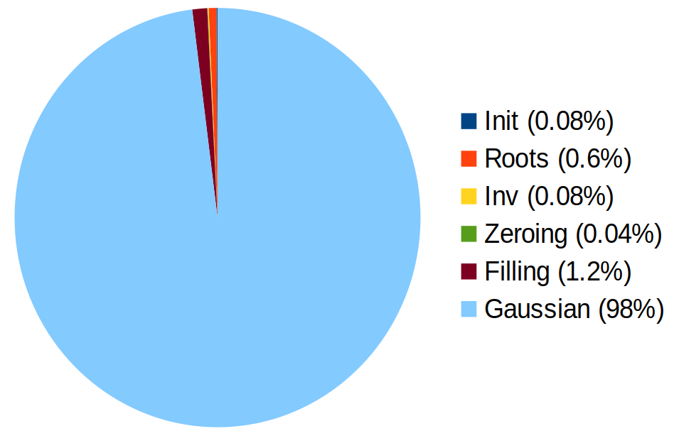
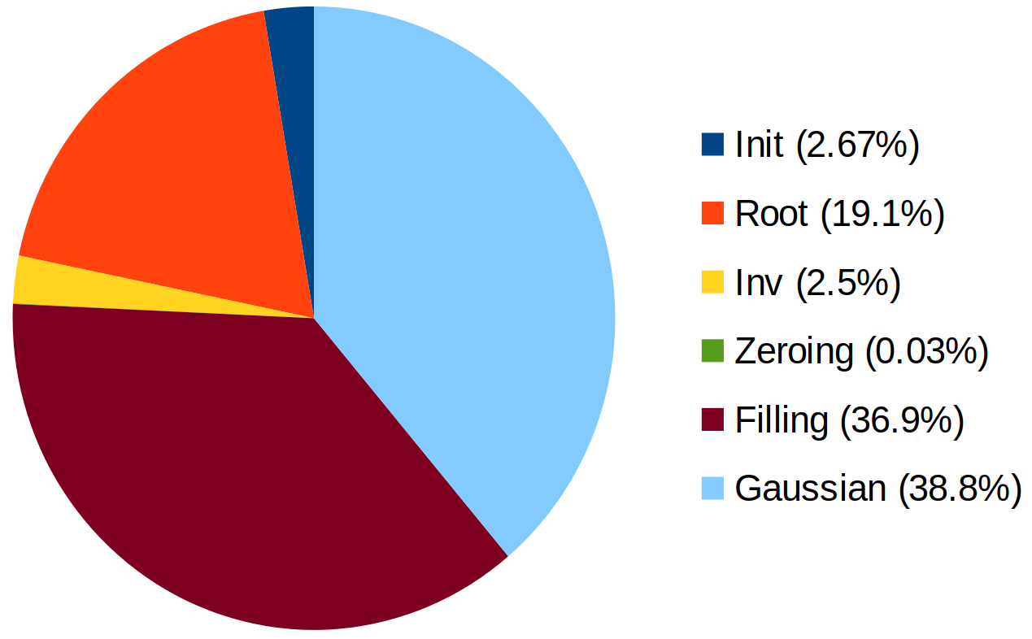
32-bit RISC-V
844 M total cycles
32-bit RISC-V
with 16KB L1 PIM cache
66 M total cycles
Classic McEliece Public Key generation - Area proportional to number of cycles
7

Slide 29
L1 Cache, 4096-bit parallelism
A
8

Slide 30
L1 Cache, 4096-bit parallelism
A
E
D
C
B
8

Slide 31
L1 Cache, 4096-bit parallelism
A
E
D
C
B
8

Slide 32
L1 Cache, 4096-bit parallelism
A
E
D
C
B
_ n - k
= m x t
_n
8

Slide 33
L1 Cache, 4096-bit parallelism
B'
B''
B
_ n - k
= m x t
_n
8

Slide 34
Classic McEliece
Parameter Set | Category | m | t | n
348864 | I | 12 | 64 | 3488
460896 | III | 13 | 96 | 4608
6688128 | V | 13 | 128 | 6688
6960119 | V | 13 | 119 | 6960
8192128 | V | 13 | 128 | 8192
m | t | n
7 | 96 | 2400
8 | 128 | 4096
9

Slide 35
Classic McEliece
BIKE
HQC
FHE ?
Parameter Set | Category | m | t | n
348864 | I | 12 | 64 | 3488
460896 | III | 13 | 96 | 4608
6688128 | V | 13 | 128 | 6688
6960119 | V | 13 | 119 | 6960
8192128 | V | 13 | 128 | 8192
m | t | n
7 | 96 | 2400
8 | 128 | 4096
?
9

Slide 36
=
+
10

Slide 37
Paramètres de Classic McEliece adaptés au calcul en mémoire
Demi-Journée Cryptographie Post-Quantique
Institut Cybersécurité Occitanie
3 Avril 2024
Cyrius NUGIER

